Slide 1

EYFS
PHONICS
WRITING
READING
MATHS

Slide 2
Aims of today…..
To share with you how phonics is taught in the Reception year at our school.
To suggest ways that you may support your child at home.
To share resources, practical tips and websites.
To explain how we teach high frequency and tricky words.
To share resources that will support your child at home.
To explain how phonics links to other curriculum areas.
PHONICS
EYFS
WRITING
READING
MATHS

Slide 3
Why teach phonics?
The ability to read has truly become a necessity to survive and thrive in today’s society . The best way to teach children to read is to ensure that a high quality, fun daily phonics programme is delivered to children.
Phonics is a method for teaching reading and writing by developing learners' phonemic awareness—the ability to hear, identify, and manipulate phonemes—in order to teach the correspondence between these sounds and the spelling patterns (graphemes) that represent them. Also………
PHONICS
EYFS
WRITING
READING
MATHS

Slide 4
Why teach phonics?
It is proven that high quality daily phonic teaching secures the skill of word recognition.
Once mastered, most children are able to read fluently and automatically.
Once children are fluent readers they are able to concentrate on the meaning of the texts that they read.
Children can then move from learning to read to reading for pleasure and purpose.
Phonics also teaches skills for spelling and therefore improves standards in a child’s writing, as well as improving general academic confidence.
PHONICS
EYFS
WRITING
READING
MATHS

Slide 5
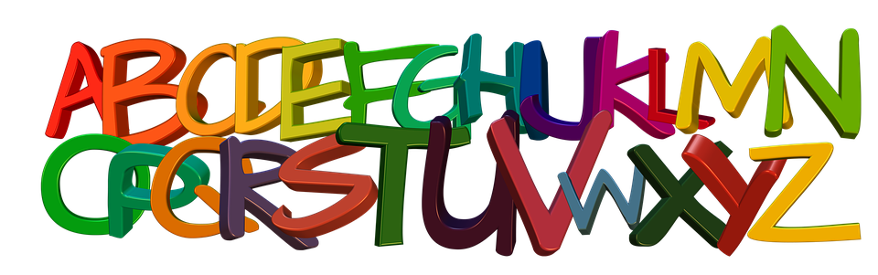
What do some of the terms mean?
Phoneme – The smallest unit of sound in a word.
Grapheme – Graphical representation of a sound/ phoneme – what the sound looks like when written.
For some phonemes, this could be more than one letter e.g. t, ai, igh
Digraph – a phoneme represented with 2 letters
Trigraph – a phoneme represented by 3 letters.
PHONICS
EYFS
WRITING
READING
MATHS

Slide 6
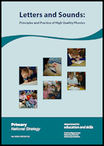
What scheme do we use at our school?
In school, we follow the Letters and Sounds programme. Letters and Sounds is a phonics resource published by the Department for Education and Skills which consists of six phases.
PHONICS
EYFS
WRITING
READING
MATHS

Slide 7
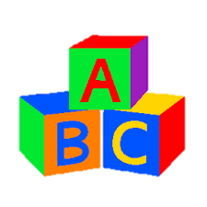

Blending and Segmenting
It is important that children know and understand how to blend and segment in order to read and spell words correctly.
Blending to read - when phonemes (units of sound) are merged together to pronounce a word. To read an unfamiliar word, a child must link a phoneme to each letter or letter group in a word and then merge them together to say the word = Grapheme-Phoneme Correspondence (GPC) e.g. sh – o – p / j– ee – p
Segmenting to spell – When individual sounds are heard in a word. To spell a word, a child must segment a word into the individual phonemes and select the relevant grapheme to represent each of these phonemes . For example a child may write:
‘The cat was blak. It had a wiet tayl and a pinc noas.’ .
PHONICS
EYFS
WRITING
READING
MATHS

Slide 8
What is a cvc word?
VC phase 2 | on | eat | off
CVC phase 2 & 3 | dog | boat | chick
CCVC phase 4 & 5 | trip | train | brought
CVCC phase 4 & 5 | tent | paint | yards
PHONICS
EYFS
WRITING
READING
MATHS

Slide 9
Phase 2
Phase 2 starts at the beginning of the Reception Year although some children will have been introduced to the first 6 sounds (satpin) in their nursery / pre-school setting. Phase 2 introduces 19 grapheme-phoneme correspondences (GPCs). As soon as children have learnt a small number of grapheme/ phoneme correspondences, blending and segmenting can begin.
Set | Phoneme | Tricky words
Set 1 | s a t p
Set 2 | i n m d
Set 3 | g o c k | I to the
Set 4 | ck e u r | no go
Set 5 | h b f ff l ll ss | into
PHONICS
EYFS
WRITING
READING
MATHS

Slide 10
Phase 3
Phase 3 introduces the remaining 7 letters of the alphabet / phonemes. Graphemes (digraphs) such as ch, oo, th represent the remaining phonemes not covered by single letters. Therefore, there are 25 phonemes within Phase 3. Once this phase is complete, children will have aquired the ‘code’ in order to blend sounds together for reading i.e. one grapheme for each phoneme in the English language. Children will also have many opportunities to learn letter names, spell tricky words, read high frequency words and will know approximately 42 phonemes in total!
Set | Phoneme | Tricky words
Set 6 | j v w x | Revise previous / he she we me be was you they are all my her
Set 7 | y z zz qu
Consonant digraphs | ch sh th ng
Vowel digraphs / trigraphs | ai ee igh oa oo ar or oi ear air ure er
PHONICS
EYFS
WRITING
READING
MATHS

Slide 11
Phase 4
This phase consolidates all the sounds that the children have learnt in the previous phases. There are no new sounds to learn. By Phase 4, children will blend phonemes to read CVC / CVCC / CCVC etc…. words and segment words for spelling. Children will have the opportunity to read simple two syllable words e.g. lunchbox, windmill. Children will practise reading all of the tricky words learnt so far and will also be able to spell some of these.
Adjacent Consonants | Tricky words
CVCC (rent) | said have like
CCVC (slug) | so do come some were
CCVCC (stamp) | there little one when
CCCVCC (sprint) | out what
PHONICS
EYFS
WRITING
READING
MATHS

Slide 12
Sound Buttons
Sound buttons
can chop
church
PHONICS
EYFS
WRITING
READING
MATHS

Slide 13
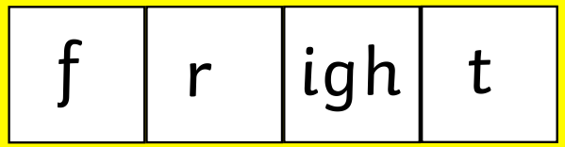

Phoneme Frames
Phoneme frames
PHONICS
EYFS
WRITING
READING
MATHS

Slide 14
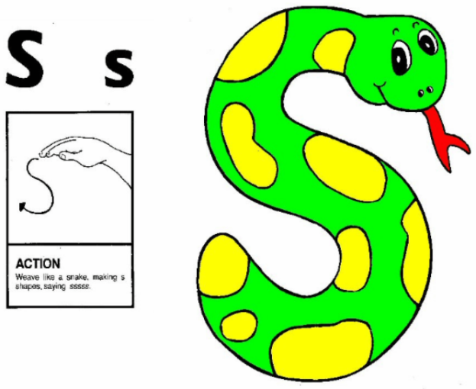
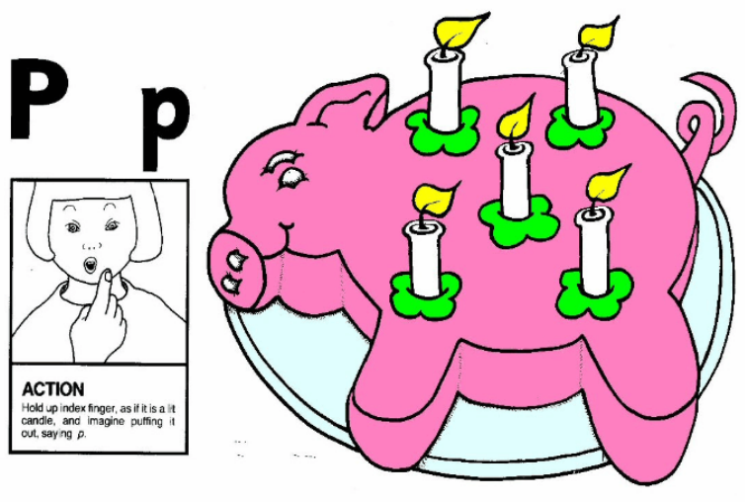
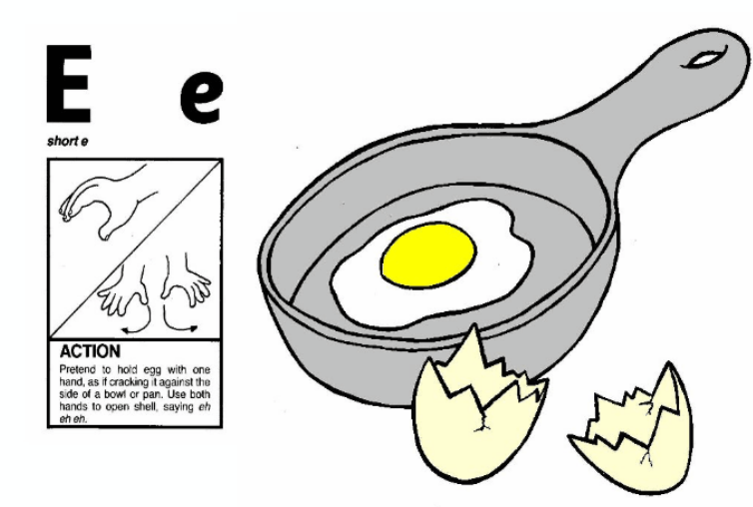
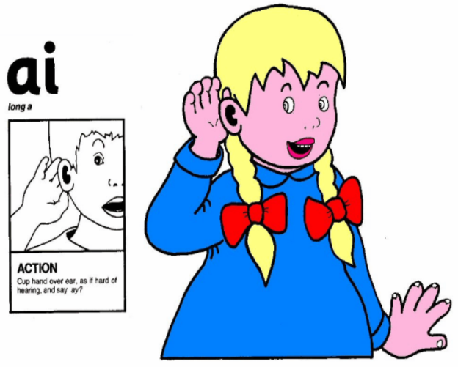
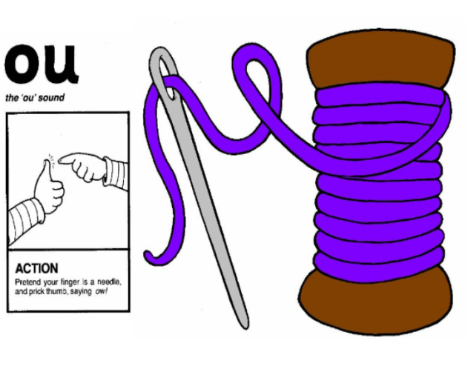
Examples of Jolly Phonics?
Jolly phonics - (sound, action, grapheme)
PHONICS
EYFS
WRITING
READING
MATHS

Slide 15
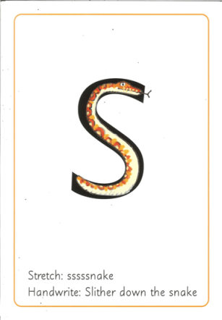
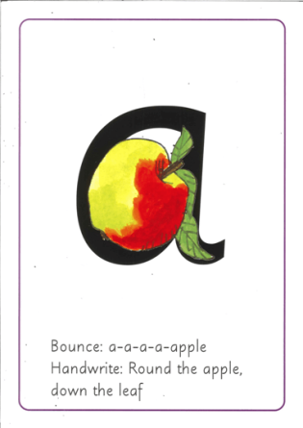
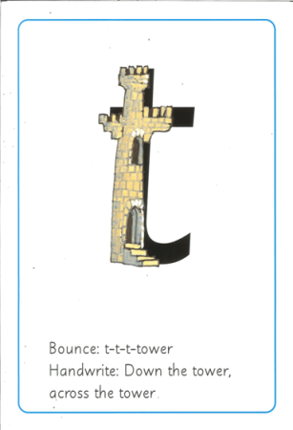
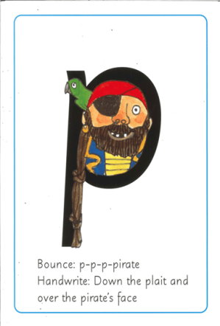
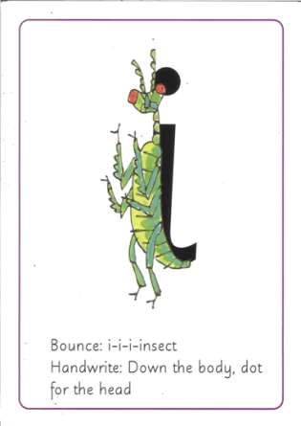
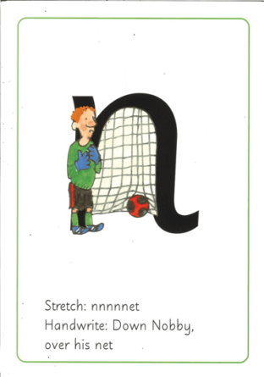

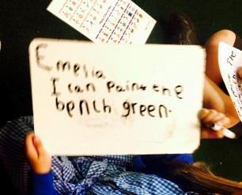
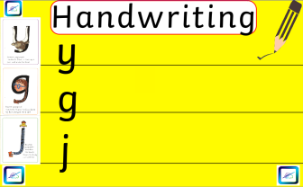
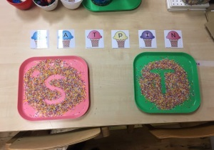
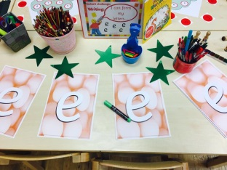
Letter Formation - RWI
Alongside learning all of the phonemes, it is important that children know how to write graphemes correctly. There are many ways that we practise this at our school.
PHONICS
EYFS
WRITING
READING
MATHS

Slide 16


Why is pronunciation important?
Careful pronunciation of sounds is very important to ensure that we are good language models to children.
Sounds should be pronounced softly and in a clipped, short manner. Not with a ‘uhhh’ sound. E.g.
Cuh aaa tuh - C-a-t
PHONICS
EYFS
WRITING
READING
MATHS

Slide 17
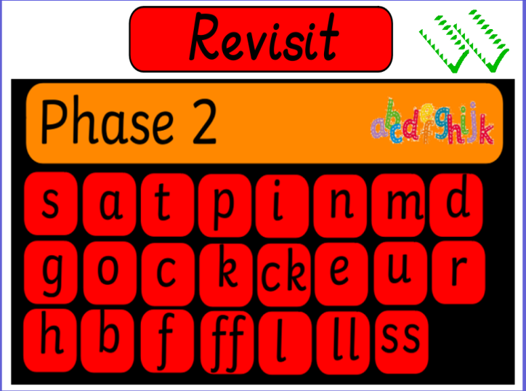
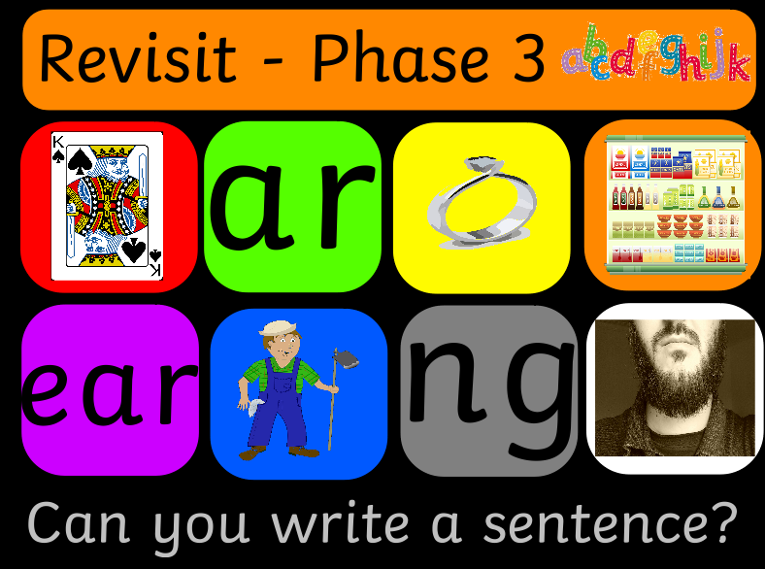
What does a daily lesson look like?
Phonics is taught daily at 9 am and usually lasts approximately 20 minutes. The format of the lesson is the same everyday which enables children to grow accustomed to the 4 different parts of the lesson. The first part of the daily phonics lesson is called:
This section of the lesson revisits previously learnt sounds and tricky words. Flashcards may be displayed to recall graphemes and the children then say the relevant sounds.
REVISIT
PHONICS
EYFS
WRITING
READING
MATHS

Slide 18
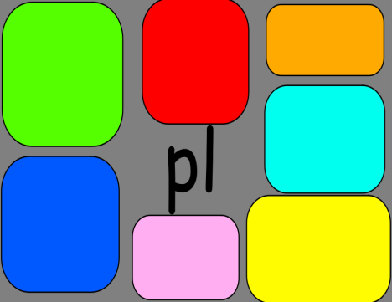
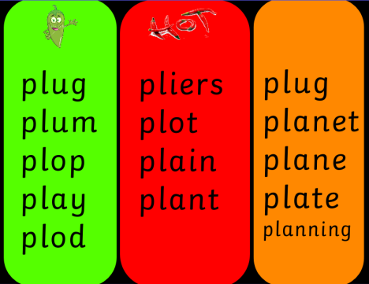
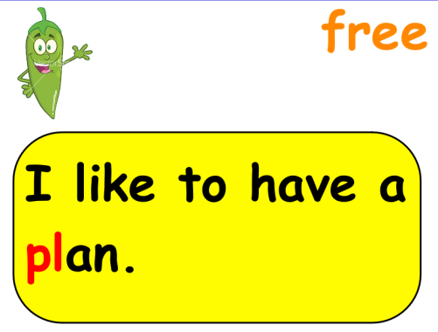
What does a lesson look like?
The second part of the lesson introduces and teaches the new sound/s of the day. The teacher models how to blend and segment throughout this section. The new Jolly Phonic action is taught and children may also have opportunities to write the new sound, forming letters correctly.
This section of the lesson also introduces new tricky words. Children may have the opportunity to read words and sentences including the new sound/s and tricky words which puts them into a context.
TEACH
PHONICS
EYFS
WRITING
READING
MATHS

Slide 19
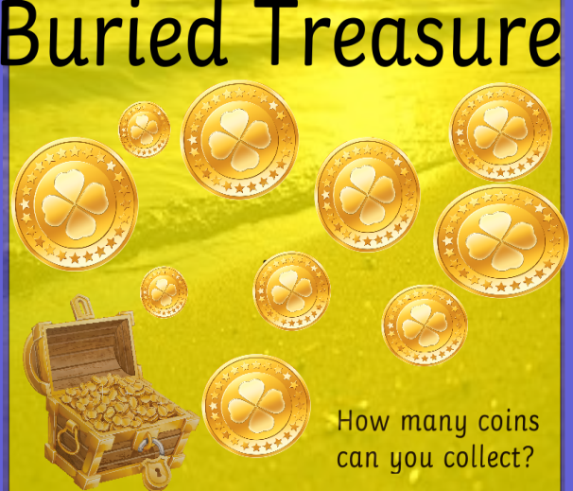

What does a lesson look like?
The third part of the lesson gives the children opportunities to practise segmenting and blending the new phonemes and tricky words. This may be done through a variety of fun games and activities
The children enjoy the variety of games and grow confident when they play them daily.
PRACTISE
PHONICS
EYFS
WRITING
READING
MATHS

Slide 20

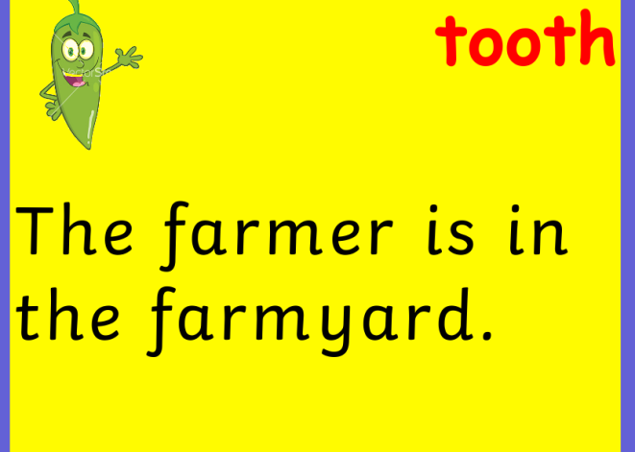
What does a lesson look like?
The final part of the lesson gives the children opportunities to apply their knowledge of the new phonemes and words.
The children may read or write simple captions or word lists and am also think of their own example.
APPLY
PHONICS
EYFS
WRITING
READING
MATHS

Slide 21

Age expectations
All children develop at different ages and stages and therefore we ensure that progress is monitored in phonics sessions regularly. This is a rough guide to where children should be in each year group.
By the end of reception, children will have been taught and know at least one way of representing each phoneme.
By the end of year 1, children will have been taught and know alternative graphemes for each grapheme and different pronunciations of the same grapheme and use these to read and spell.
By year 2, children are applying their phonic knowledge and recognising irregularities to spell more complex words and notice spelling patterns.
PHONICS
EYFS
WRITING
READING
MATHS

Slide 22
High Frequency words?
High frequency words (keywords) are words that we use regularly when we speak, read and write. Some of these words can be sounded out phonetically but many can’t. Those that can’t are called tricky words.
Tricky words are taught as WHOLE words by sight.
We send home KEYWORDS in your child’s phonics book.
There are several ways that we learn these…….
Write the word three times. Trace over it in different colours.
Look, say, cover, visualise, write, check.
Play bingo with the words.
Write the word in a nonsense sentence.
Find words with similar patterns. e.g. the, them, they
Write the word, draw around the shape of the word and cut out.
PHONICS
EYFS
WRITING
READING
MATHS

Slide 23

What can you do at home?
The more phonics practice that children have the better and therefore it is so beneficial if you can support your children at home as and when you can. Not too much! Just five minutes a night is ample. Children may even want to do more as they become more confident!
Your children will receive new keywords as they learn them and by the end of the year the book will contain all of the phonemes for the Reception Year.
Please do remember to keep it entertaining
and as practical as possible!
HAVE FUN!
PHONICS
EYFS
WRITING
READING
MATHS

